Slide 1

Human Connection:
The Cornerstone of Successful Online Teaching and Learning
Human Connection:
The Cornerstone of Successful Online Teaching and Learning
Presented by: Jess O’Reilly
Access via: bit.ly/tessjess
Photo by Robson Hatsukami Morgan on Unsplash
Notes:
This presentation was delivered at eCampus Ontario’s Technology-Enabled Seminar and Showcase event on Monday, November 18 from 3:30pm - 4:10pm on Floor 17, Event Hall 1.

Slide 2
Hey you! Hit record.
Notes:
Here is the original session synopsis, just for your information.
As an online educator and scholar of distributed and open education, I have experimented with several engagement strategies intended to foster a Community of Inquiry, a framework for collective learning that occurs within and at the intersections of social, cognitive, and teaching presences (see Garrison, Anderson, and Archer, 1996 and 2000; Cleveland-Innes and Wilton, 2018).
I would like to share a few audience-selected examples of how I intentionally design and deliver asynchronous learning experiences aimed to support social, cognitive, and teaching presences within my college-level online courses. These examples will provide a jumping-off point for individual reflection and grouped discussions about the various ways that workshop participants might also design and deliver asynchronous online education in support of a Community of Inquiry.

Slide 3

Hi!
Photo by Vladislav Klapin on Unsplash
Notes:
If you’ve ever had the chance to see Stephen Downes present or teach, you may have noticed how he uses interesting verbal tags to organize his talks. He says things like, “This is the part of the presentation where I…” I think it’s at once a pragmatic, and fairly hilarious strategy...
This is the part of the presentation where I’m supposed to introduce myself and summarize my credentials and experience so that you can ascertain whether or not I have the credibility to be taken seriously. However, if you’re in the room already, you can’t really escape now can you? If you’re reading the slides online, you found them somewhere and made the choice to click.
So all I want to say at this point is Hello! Aanii! Kwey Kwey! Welcome! Thank you so much for spending this bit of time with me. I’ll talk about my experiences throughout the presentation, so for now I’ll just say that if you’d like to continue this conversation, find me on Twitter @Cambrian_Jess. I also have a little website too, www.jessoreilly.ca.

Slide 4

Here’s a Plan
Overview of the Community of Inquiry framework
Introduce Social Presence and a few examples
  You pick one example for me to expand on
  I’ll react accordingly
Do the same with Teaching Presence and Cognitive Presence
Discuss
Please feel free to use the Zoom Chat feature or to enable your mic and interject your thoughts, questions, and/ or criticisms at any point throughout the presentation.
Notes:
Recently, like last year, I stopped asking myself “how to teach online?” and started to ask myself “how will I teach online?” This was a really emancipatory shift im my practice.
I am a person who really appreciates stories and conversation, and actively resists sweeping statements about BEST practice, standardized templates, false dichotomies. So I’m not coming in here trying to lecture you about what you SHOULD or MUST do. Everyone’s context is unique. Everyone will approach their practice in an individual way. Our strategies are highly dependent upon our learners, our institutional contexts, and ourselves.
That said, I think we learn a great deal about ourselves and each other through narrative. So, in the limited time that we have together, I’d like to tell you a few stories. I’d like to tell you about the community of inquiry model and how connecting this framework to my online teaching practice prompted some new ideas and ways of thinking about teaching online. I’d like to share a few examples of the ways that I’ve tried to build social, teaching, and cognitive presences within my courses.
My hope is that by sharing my ideas, which were definitely inspired by others who shared their ideas, I might prompt some ideas in you. Maybe you’d like to try one or two of these examples in your courses. Maybe something I mention will remind you of a thing you did that worked well, an idea that you wanted to try but forgot about, or maybe something shared by another participant will send you down a rabbit hole that you’d like to explore.

Slide 5
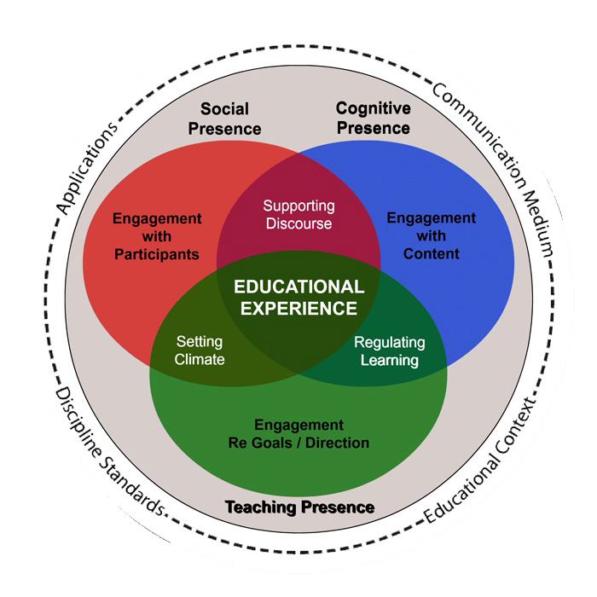
Community of Inquiry
(CoI)
2 minutes
“Community of Inquiry Framework [Image]” by Garrison, Cleveland-Innes, and Vaughan is licensed under CC BY-SA 4.0
Notes:
The community of inquiry (CoI) was first applied to the elearning context in the late 90s and early 2000s by Randy Garrison, Terry Anderson, and Walter Archer, three notable Canadian academics and thought-leaders in the field of distributed learning. Since their original publication, hundreds of researchers have applied, critiqued, expanded upon, and modified the framework, which is deeply rooted in social constructivist learning theories.
I’m not going to provide an exhaustive overview today, but I will use the three interdependent presences identified by the framework to anchor my sharing. We’ll focus specifically on the social, teaching, and cognitive presences. Why? The research suggests a strong connection between these three presences and learner satisfaction in fully online courses (Kucuk & Richardson, as cited in Garrison, 2019).
If you’re new to online teaching, envisioning your delivery through these presences might be quite helpful. If you’ve been teaching online for awhile, self-evaluating your online teaching practice through these presences may alert you to some bias and gaps. For example, when I first came to this framework it helped me to realize that I’d been undervaluing, and therefore underrepresenting, social presence within my deliveries, and so I started thinking about ways I might adjust.
Additional resources:
Here’s a link to the original Garrison, Anderson, and Archer publication
Here’s a link to a CoI for the CoI!
Here’s Randy Garrison explaining the presences in a recent editorial (October 30, 2019)
Norman Vaughan, Marti Cleveland-Innes, and Randy Garrison applied the CoI to blended learning environments in this ebook (freely available online)
You can use this CoI survey (CC BY-SA, validated) to assess the operationalizing of the CoI in your own teaching context
There are also many great overview videos on YouTube :)

Slide 6

Social Presence
Photo by Marvin Meyer on Unsplash
Notes:
Social presence is “the ability of participants to identify with the community (e.g., course of study), communicate purposefully in a trusting environment, and develop interpersonal relationships by way of projecting their individual personalities” (as cited in CoI Framework, n.d.).
Social presence consists of activities related to emotional expression, open communication, and group cohesion.
Examples include: emotions, risk-free expression, encouraging collaboration.
Additional Resources:
David Dutrow describes social presence in this (2018) YouTube video.
For those who prefer muddy waters, check out David Annand’s (2011) IRRODL article, which questions and critiques the role of social presences within the CoI framework and its importance in online learning environments. He adds interesting nuance to the conversation.

Slide 7
Example 1:
The
Proust Questionnaire
Example 2:
Art Making & Poetry Writing
Example 3:
The
Easter Egg
Hunt
Notes:
This is the part of the presentation where I share three examples of how I strategically cultivated social presence within a few of my online deliveries, and you choose one for me to elaborate upon.
In the first example, I presented students with a seemingly innocuous icebreaker-type survey, based on the classic Proust Questionnaire. It asked students VERY personal, deep questions and helped me segue into a discussion about critical thinking, privacy, and deschooling (in the Ivan Illich sense of the term). The (somewhat) unexpected outcome was beautifully honest sharing of emotions.
In the second example, I thwarted the standard discussion forum in favour of a few less conventional approaches, inviting students to participate in anonymous and collaborative art making and poetry writing. These are examples of fostering risk-free expression in the online space.
In the third example, I invited students to participate in a semester-long Easter egg hunt, the central purpose of which was to create opportunities for friendly social interaction between the learners and I through a bit of ancillary gamification.

Slide 8

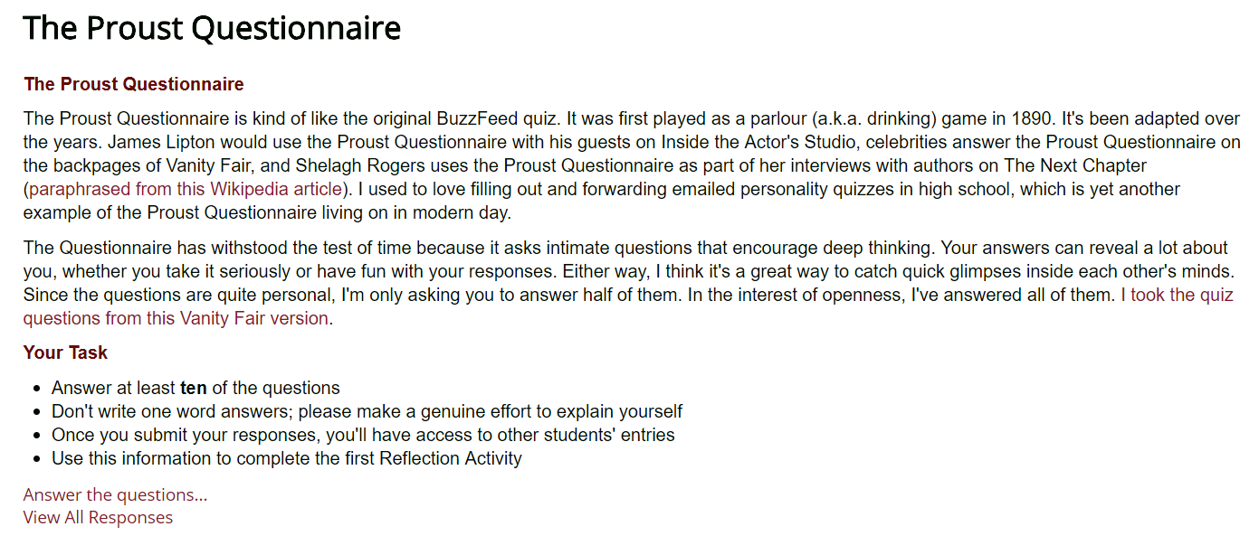
Social Presence Example 1:
The Proust Questionnaire
“This survey is about to know more about me than I know about myself!”
student sharing screenshot of Proust Questionnaire on their Instagram feed
Notes:
This activity was inspired by a former student, who wrote this blog post titled “A Two Way Street: Effective Relationship-Building with your Teacher”. Brittney notes that students are often expected to write honest and transparent reflections after spending only a few hours with a professor in a grouped environment. She writes, “Don’t you find it interesting how sometimes you barely know a teacher but they expect you to write papers with vulnerability and emotion? [...] Some of us have a hard enough time doing this with our loved ones, let alone someone we’ve know for 3 hours per week. Does anyone else find it challenging?” (Babin, 2018).
After administering the Proust questionnaire, I introduce Brittney’s perspective and ask students to reflect on their participation in the questionnaire, asking them:
Did you consider refusing to answer the Proust Questionnaire?
What empowered or silenced you?
Is it important to you that your teachers demonstrate trust and vulnerability if they expect it in return?
Here is a link to the full assignment description. This is the assignment that students wrote AFTER completing the Proust Questionnaire.
The actual Proust Questionnaire lives in Moodle, so I can’t link to it here. Here’s the full list of questions that students had to select from (I answered all of the questions, students were asked to answer at least half of them).
What is your idea of perfect happiness?
What is your greatest regret?
What is one thing about yourself that you dislike?
What is one thing about other people that you dislike?
Which living person do you most admire (and why)?
What is your greatest indulgence?
What is your current state of mind?
What do you consider to be the most overrated character trait?
Under what circumstances do you lie?
What do you most dislike about your appearance?
Which words or phrases do you most overuse?
What or who is the greatest love of your life?
When and where were you happiest?
Which talent would you most like to have?
If you could change one thing about yourself, what would it be?
What do you consider your greatest achievement?
What is your most treasured possession?
What is your motto?
Who are your favourite artists?
What is your greatest fear?

Slide 9
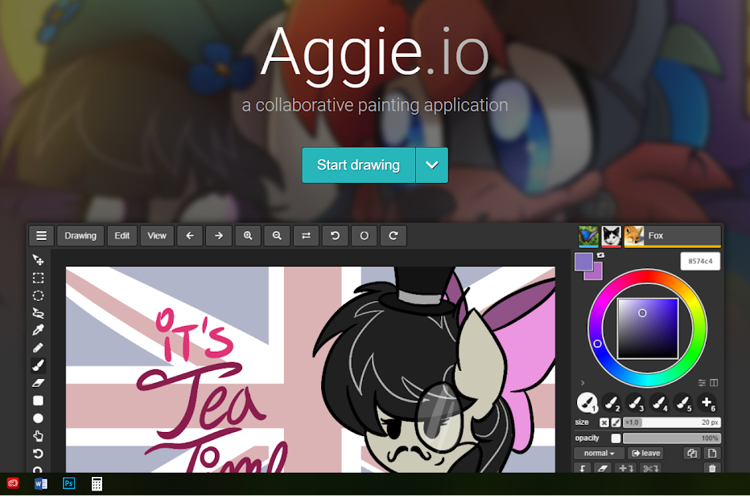
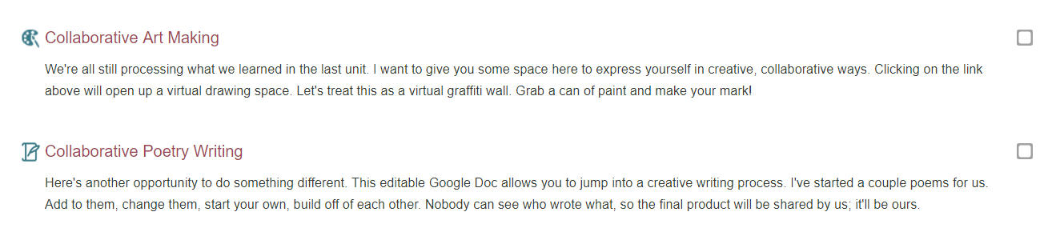
Social Presence Example 2:
Art Making and Poetry Writing
Click here to try an Aggie
Notes:
I’m always banging my head against a wall, trying to imagine ways for students to connect and collaborate with each other in a tech-enabled ways that don’t force yet another mandatory text-based discussion forum on them. I’ve been an online student for a very long time, and I’ve grown to DETEST text-based discussion forums. This bias, along with student non-participation in text-based discussion forums, has led me to try out new approaches all the time.
Here’s two strategies to consider, if you’re interested in inviting students to collaborate and express themselves freely and openly.
Check out Aggie.io, a collaborative, web-based painting application that is very much in the alpha stages of development. Remember MS Paint? It’s that, but online and shared with a link. It’s designed to be browser agnostic (in theory) and updates in real time. I invited my students to join me in creating a virtual graffiti wall, and didn’t really direct their participation beyond an initial invite. Here’s the result.
Another low-stakes collaborative opportunity I tried out was some anonymous poetry writing. Here’s a link to the resulting document. You have edit access if you’d like to contribute!

Slide 10
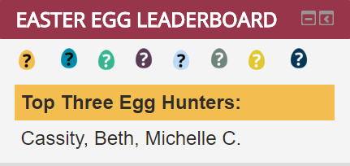
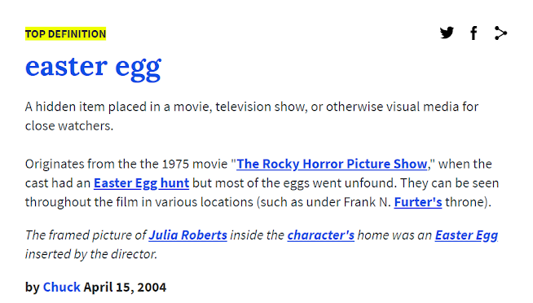
Social Presence Example 3:
The Easter Egg Hunt
Overview of the Easter Eggs I planted in SSC 1002
Notes:
I saw this idea on Twitter, though I can’t find a proper attribution. Someone had snuck a little “Easter egg” into their syllabus. Students had to read carefully and completely to notice the Easter egg, which prompted them to email the professor to earn a little prize. I thought, what if I did this throughout an entire course? As a just for fun, pay close attention to play the game, sort of experience.
Some students ignored the game. Some got right into it. I got to have brief little social interactions with the students who decided to play along, since identifying an Easter egg always prompted them to email me with a specific subject line in order to claim the prize.

Slide 11

Teaching Presence
Photo by Matheus Cenali on Unsplash
Notes:
Teaching Presence includes “the design, facilitation, and direction of cognitive and social processes for the purpose of realizing personally meaningful and educationally worthwhile learning outcomes” (CoI Framework, n.d.).
Teaching presence consists of activities related to instructional management, building understanding, and direct instruction.
Examples of teaching presence include defining and initiating discussion topics, sharing personal meaning, and focussing discussion.
Additional Resources:
This webpage lists several papers that focus primarily on the Teaching Presence component of the CoI.
Dr. Norm Vaughan discusses teaching presence in this short YouTube video.

Slide 12
Example 1:
Icons,
Headings & Checklists
Example 2:
Early F2F & Virtual 1-1 Meetings
Example 3:
Prototyping Course Content & Assessments
Notes:
Here are three examples of how I design my courses to help support and direct cognitive processes, examples of how I actually go about teaching online.
In the first example, I share some of the more basic instructional design strategies I use to organize and direct the learning path. My hope is that these strategies help learners move through asynchronous online units with intention and clarity.
In the second example, I share a strategy that I tried for the very first time at the beginning of the current semester. I invited all of the students enrolled in my online course to meet up with me for 15 minutes, either on campus, virtually, or over the phone. I’ll tell you more about the outcome of that little experiment in facilitating discourse.
The third example showcases the basic templates or prototypes that I use for regular content conveyance and summative assessments, examples of direct instruction.

Slide 13

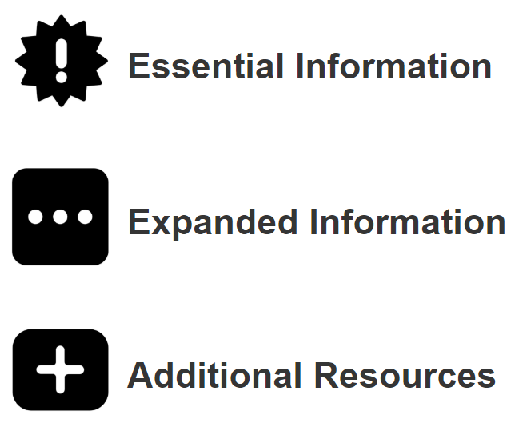
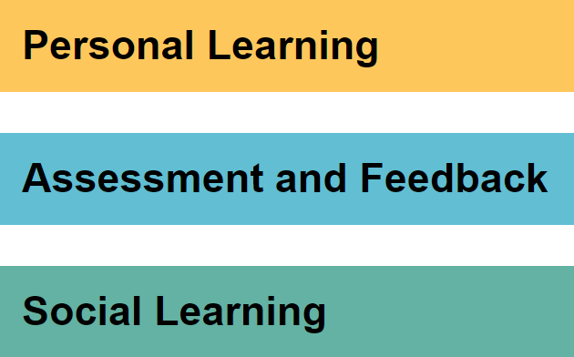
Teaching Presence Example 1:
Icons, Headings & Checklists
Course Structure Overview GDoc for SSC 1002
Example Weekly Guide (Student-Facing) that is linear and action-oriented, basically a checklist
Notes:
When I consult with faculty who are new to teaching online, they often appear visibly relieved when I share this design strategy. I encourage them to think about how their units of content might be designed and delivered within a predictable, repeating framework. The framework will look different depending on the educator, the course, and the students enrolled, and I am continuously rethinking this approach as my teaching context changes. However, it might offer a good starting point for those of you who are looking to design online learning.

Slide 14
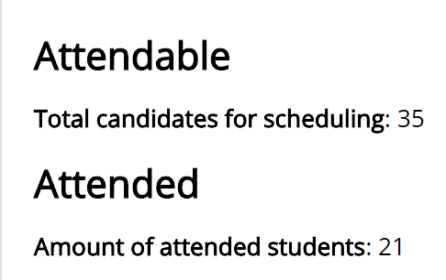
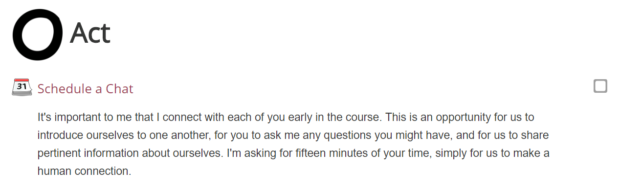
Teaching Presence Example 2:
Early Face-to-Face and Virtual 1-1 Meetings
“I’m in my second year, but you’re the first prof that I’ve...met”
Notes:
A few years ago, I started a Doctor of Education (EdD) in Distance Education through Athabasca. I thought it was pretty interesting that a mandatory requirement of this otherwise fully online program was a week-long orientation that took place in Edmonton, in late August. To be accepted into and to continue in the Doctorate in Distance Education program, I needed to travel halfway across the country for a full week, at one of the worst times of the year for me to be out of office. Cool.
Obviously this mandatory face-to-face communicated something about the value of this type of connection. I thought about what might happen if I did a mini version of this meet-up in my online classes. If I invited students to meet with me, just to put a face to the name and chat a bit about who we are and what the course would involve, would they take me up on it?
Finally, this semester, I tried it out. About 60% of my students did meet up with me. Many of the students who didn’t registered for the course a bit later. I should have reached out to them with a personal invite to meet. I bet if I did, the numbers would be higher. Students self-selected into this meetup, and came to it with their own goals in mind.
I hope that this strategy communicated openness and availability. That this brief social and teaching presence opened doors for further interactions and engagements throughout the semester. I suspect it did.

Slide 15

Teaching Presence Example 3:
Prototyping Course Content & Assessments
Content Template
Assessment Template
Notes:
I mentioned before that I’m not a huge fan of templates, but that doesn’t mean I don’t use them! I like for my courses to have an aesthetic that runs through the Moodle shell, the course content, the assignments, and the like. It ties everything together and puts a certain amount of polish on the thing, I think.
It also helps me to remember to include certain elements in my assessments, and makes the experience feel more predictable and manageable on the student side, or so I’ve been told.
This slide contains a few example templates from my more recent delivery. Here’s an example of actual content, and here’s an example of an actual assessment. The Weekly Guide also adopts this aesthetic too - pretty much everything in the course does!

Slide 16

Cognitive Presence
Photo by Dallas Reedy on Unsplash
Notes:
Cognitive Presence is “the extent to which learners are able to construct and confirm meaning through sustained reflection and discourse” (CoI Framework, n.d.).
Cognitive presence general includes some or all of the following: a triggering event, exploration, integration, and resolution, as exemplified by a sense of puzzlement, information exchange, connecting ideas, and applying new ideas in different scenarios.
Additional resources:
UC Davis provides a nice overview of cognitive and social presence here.
Daphne Koller delivers an amazing TED talk here.

Slide 17
Example 1:
Weekly Welcomes
Example 2:
Informal Learning within
a Summative Assessment
Example 3:
Renewable Assignments
Notes:
In the first example, I share some of my strategies for reaching out to students each and every week, reminding them about their online course obligations. This represents a triggering event of sorts.
In the second example, I’ll share an assignment that asked students to go beyond the LMS and have a conversation with an actual human not enrolled in the course, an example of information exchange and idea formation.
In the last example, I share a few examples of renewable, public-facing assignments that students have or are currently creating in my courses. This is an example of open pedagogical practice, yet another way for students to share their knowledge and engage in discourse beyond the LMS.

Slide 18
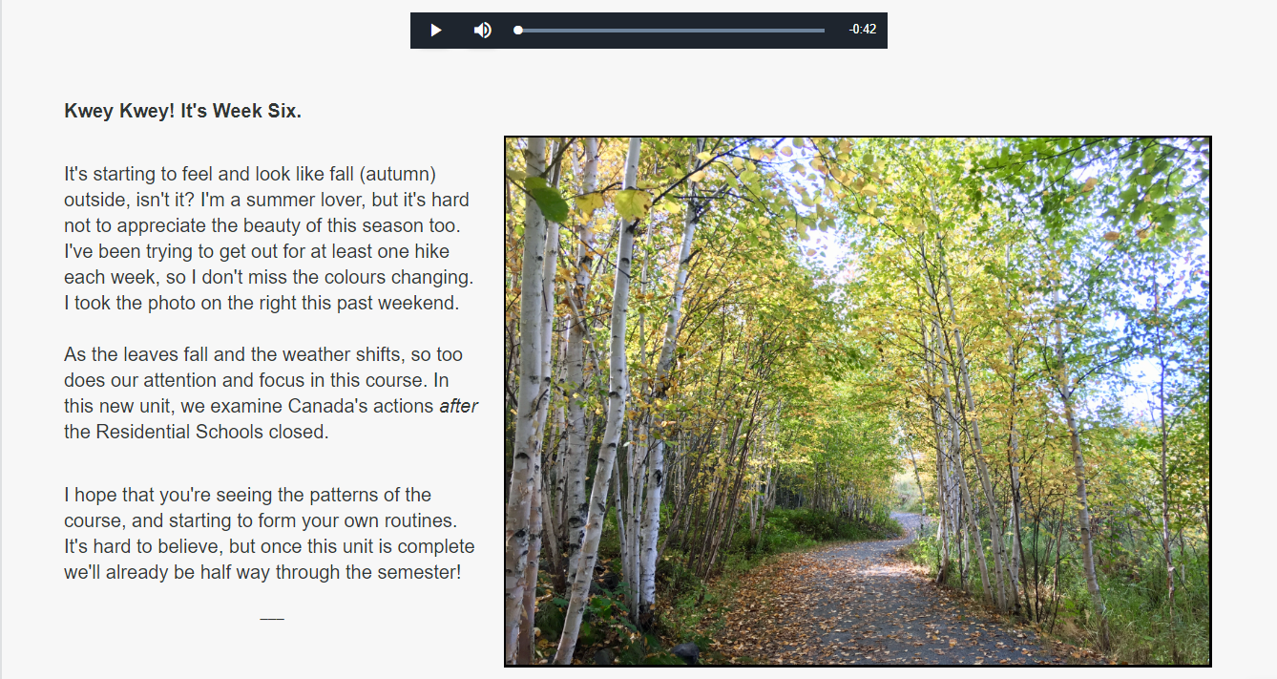
Cognitive Presence Example 1:
Weekly Welcome
Notes:
The Weekly Welcomes may not represent a true triggering event, since I don’t really use them to instigate a sense of excitement and wonder, but rather use them to remind students about their online course! I find it essential to reach out to students at least once, if not twice, per week.
In my current delivery, I send students out a Weekly Announcement which lands in their inbox, and I also update the actual Moodle shell with a little weekly “Kwey Kwey” (Hey Hey!). This is a way for me to also maintain a bit of a teaching presence while also keeping the course feeling alive and in motion. I keep my emailed announcements simple, but often add audio and visual elements to the updates that live in the course shell.

Slide 19
Cognitive Presence Example 2:
Informal Learning within a Summative Assessment
Sometimes it’s nice to
bust out of the LMS!
Notes:
I many have mentioned my bias toward discussion forums already, depending on which slides were selected by the group. I value social learning, but find that synchronous online students struggle to communicate effectively via text-based forums, tend not to enjoy them, and prefer to work at their own pace, rather than having the frequency of their engagement with the course dictated to them, as the “post once respond thrice” mantra of the discussion forum often dictates.
I’d like to share here an assignment that actually proved to be quite successful and powerful, I think, particularly as it made space for informal discussion with students’ friends, family members, coworkers, etc. and not necessarily with other course participants. Here is a link to the full assignment description.
I guess my main reason for sharing this example is to encourage you to think about how you might value and make space for informal learning within your online teaching practice. Conversations with humans outside of the bounds of the course offer great opportunities for learning, but cannot be micromanaged and tracked the same way that engagement within the LMS can be. Are you okay with that?

Slide 20
Cognitive Presence Example 3:
Renewable Assignments
Students were invited to contribute to a website re: UNESCO’s SDGs
Here’s the assignment description
Here’s the resulting website
Currently, students are invited to contribute to a website re: the TRC’s Calls to Action
Here’s the assignment description
Here’s the soon-to-be-populated website
Notes:
I’m an open education advocate, practitioner, and would-be researcher. In the past few years I’ve started dabbling in renewable assignments, starting small and taking larger leaps into what can feel like uncharted territory, though I know full well that others are doing these sorts of things too. It still feels risky and new, though, and I think that’s worth acknowledging.
My practice is largely informed by this recently published IRRODL article, written by David Wiley and John Hilton III, describing OER-Enabled Pedagogy.

Slide 21

How will
you
teach online?
bit.ly/tessjess
Notes:
Here’s the part of the presentation where I turn it over to you. How would you like to fill our remaining time together? Perhaps we can check out the Google Doc to see if anyone’s shared any questions, ideas, or the like.
Thank you for allowing me to share some of my ideas and approaches. I’d love to hear more about yours. You can reach me on Twitter @Cambrian_Jess, or via email at jessica.oreilly@cambriancollege.ca.

